Slide 1
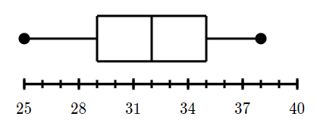
24
7
30
Box and whisker plots
Date
EQ – how do we create a box and whisker plot?
A box and whisker plot is also called a box plot
It displays the five-number summary of a set of data.

Slide 2
25 , 28 , 29 , 29 , 30 , 34 , 35 , 35 , 37 , 38
Min =
1st Q =
Med =
3rd Q =
Max =

Slide 3
Stem | Leaf
0 | 1 4 9 9 9
1 | 3 8 8 9
2 | 5 9
3 | 5
Min =
1st Q =
Med =
3rd Q =
Max =

